Slide 1



LOW-COST CONVEYOR-BASED
MICRO LOGISTICS SYSTEM FOR
WAREHOUSES
KNOWLEDGE INSTITUTE OF TECHNOLOGY

Slide 2
LOW-COST CONVEYOR-BASED MICRO LOGISTICS SYSTEM
KNOWLEDGE INSTITUTE OF TECHNOLOGY
A low-cost conveyor-based micro logistics system designed to automate the movement and sorting of packages within small-scale warehouses.
By combining modular conveyor mechanisms, sensors, microcontroller-based control, and automated sorting, the system enables efficient material handling, reduces manual labor, minimizes operational costs, and provides reliable package transportation between different warehouse sections.
2

Slide 3

KNOWLEDGE INSTITUTE OF TECHNOLOGY
Flow Chart
START → Power ON → ESP32 Initializes → Package Placed → IR Sensor Detects → ESP32 Processes Signal → Conveyor Moves → Package Transported → Next Package → END
Application
Small warehouses
Parcel handling
Educational automation prototypes
3

Slide 4
Working Methodology
KNOWLEDGE INSTITUTE OF TECHNOLOGY
Power on and initialize the conveyor system.
Place the package on the conveyor belt.
Sensors detect the package automatically.
The microcontroller processes sensor signals.
The motor moves the package forward.
The sorting mechanism directs the package.
The package reaches its assigned destination.
4

Slide 5
KNOWLEDGE INSTITUTE OF TECHNOLOGY
System Features
EXISTING SYSTEM
Small-scale material handling is often done manually, which requires more time and effort. Manual movement can cause delays, errors, and inefficient package handling.
PROPOSED SYSTEM
The proposed system uses a low-cost conveyor, sensors, motor, and microcontroller to automate package movement and sorting. It provides faster handling, reduces manual effort, lowers cost, and improves efficiency.
5

Slide 6

KNOWLEDGE INSTITUTE OF TECHNOLOGY
Solution Architecture
Power Supply & Control Unit – Provides power and controls the complete system.
Conveyor Module – Moves packages smoothly from one point to another.
Sensor Module – Detects packages and tracks their position.
Microcontroller Unit – Processes sensor data and controls system operation.
Sorting Mechanism – Automatically directs packages to the required destination.
Output Section – Collects and delivers sorted packages efficiently.
6

Slide 7
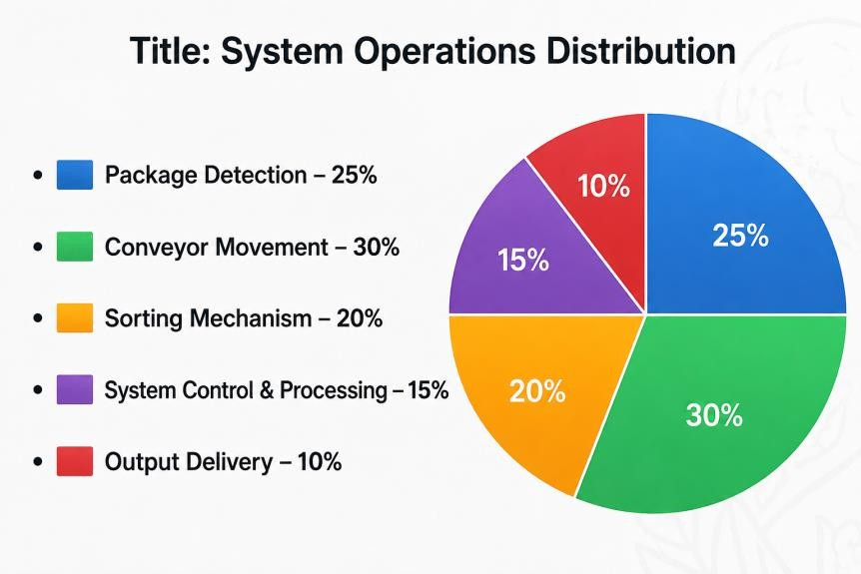
KNOWLEDGE INSTITUTE OF TECHNOLOGY
Demonstration breakdown
Package Detection – Sensors detect each package automatically.
System Start-up – The conveyor and control unit are initialized.
Package Placement – Packages are placed on the conveyor belt.
Conveyor Movement – The motor moves packages along the conveyor.
Package Sorting – The system directs packages to the correct section.
Final Collection – Sorted packages are collected at their destinations.
7

Slide 8
KNOWLEDGE INSTITUTE OF TECHNOLOGY
CONCLUSION
Implementation Outcome
The proposed Low-Cost Conveyor-Based Micro Logistics System provides an affordable and efficient solution for small-scale material handling. By integrating a conveyor belt, sensors, motor, and microcontroller, the system automates package movement and sorting. It reduces manual effort, saves time, minimizes handling errors, and improves overall logistics efficiency. The system is simple, cost-effective, easy to operate, and suitable for small warehouses, workshops, and educational applications.
8

